Slide 2

Monday,September 19th 2022
UNIT 1: MY NEW SCHOOL
Lesson 6: Skills 2 p.13
Nguyen Thi Hai
Thai Son secondary school

Slide 3

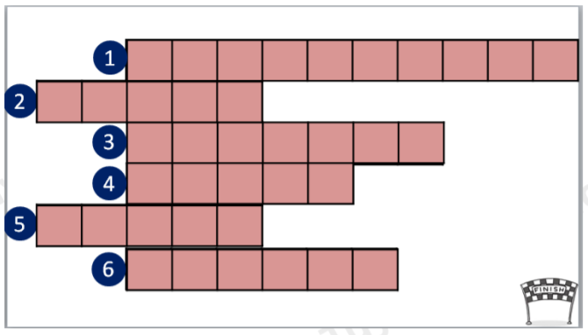

WARM - UP:
Game: Crossword Puzzle
1. This is an area designed for children to play in outside, especially at school or in a park.
P L A Y G R O U N D
2. This is an adjective used to describe people who have a clean, tidy and stylish appearance.
S M A R T
L E S S O N S
3. Complete the following sentence with a suitable word:
Mrs Nguyen teaches all my history _____.
M U S I C
D R E A M
4. What is this subject? – [visuals]
R U B B E R
5. What is this school thing? – [visuals]
6. This is a small electronic device that is used for calculations.

Slide 4


Listening

Slide 5



Janet, a student at Palmer School in America, is talking about her school. Guess the answers to these questions.
1.
Do you think the students there wear uniforms?
2.
Do they learn Vietnamese as a foreign language?
Listen to the talk and check your guesses.
Audio script

Slide 6
AUDIO SCRIPT
Hi. My name's Janet. I'm eleven years old. I'm now in year 6 at Palmer School. I like it here. My classmates are friendly. The teachers at my school are nice and very helpful, and my favourite teacher is Mrs. Smith. She teaches us maths. I have two hours to study Vietnamese every week. I usually do my homework in the library. We wear our uniforms every day, but today we aren't. We're going to have a biology lesson on a farm.

Slide 7


Listen again and choose the correct answer A or B.
Quiz
1.
Janet’s favourite teacher is her teacher.
A.
maths
B.
science
2.
Today Janet her uniform.
A.
is wearing
B.
isn’t wearing
3.
Janet studies for two hours a week.
A.
B.
Vietnamese
English
4.
Janet usually does her homework .
A.
B.
at home
in the library
5.
Her class is going to have a biology lesson .
A.
on a farm
B.
in the classroom

Slide 8
Writing

Slide 9

Write the answers to the following questions about your school.
1.
What is the name of your school?
Thai Son secondary school
2.
Where is your school?
It’s in Thai Son commune
3.
How many classes does your school have?
It has 19 classes
4.
What do students do at your school?
They often play games at breaktime
5.
What do you like about your school?
It has a big playground and people are friendly

Slide 10


Use the answers in 3 to write a paragraph of 40-50 words about your school. You can refer to the reading passages to help you.
My school is

Slide 11
Use the answers in 3 to write a paragraph of 40-50 words about your school. You can refer to the reading passages to help you.
Sample paragraph
My school is Thai Son School. It is in the centre of my village. It has 19 classes with over 800 students. We study many subjects: maths, history, science, and of course, English. We often play games during break time. My teachers are friendly, and my friends are helpful. I like my school very much.

Slide 12
Home Asignments;
Write a paragraph of 40-50 words about your school

Slide 13


Thanks you
Goodbye
See you again!!!

